Slide 1
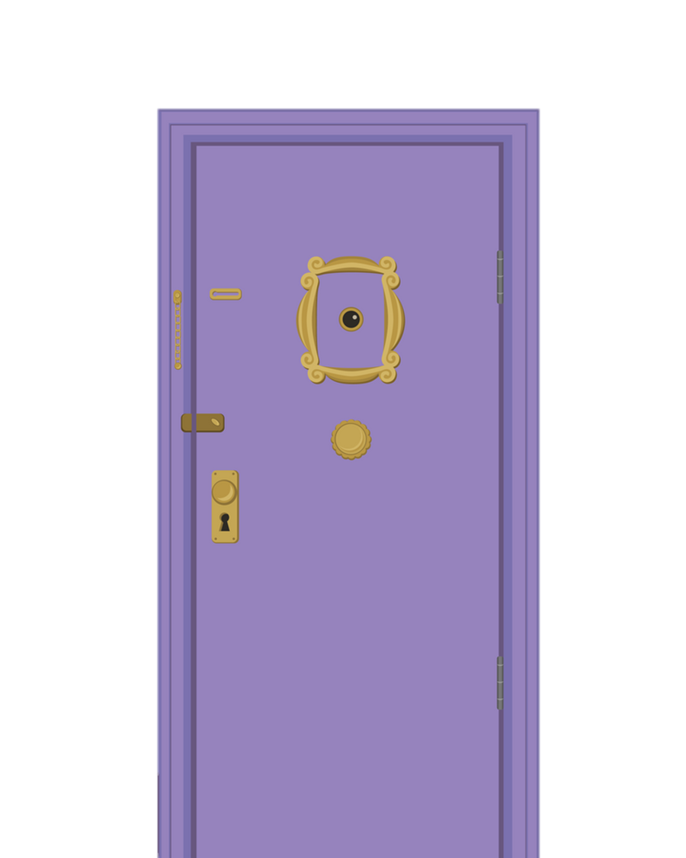


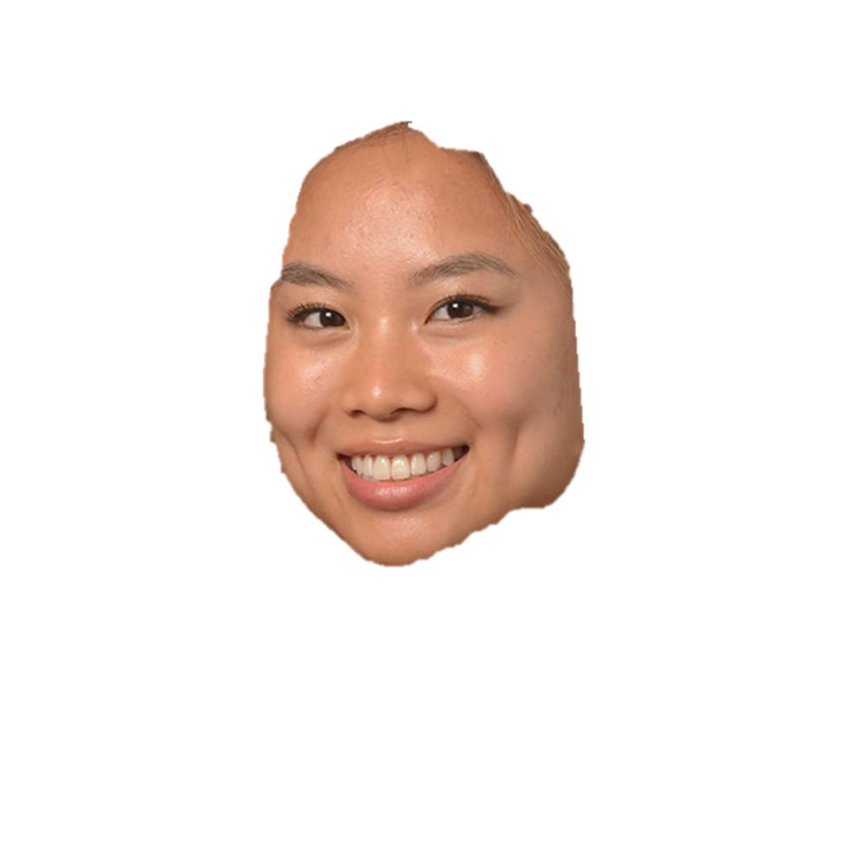




Could we BE analyzing any more scripts? A Text Analysis of the sitcom Friends
Blue 19
Nikhil Suthar, Cameron Bumgarner, Kathleen Dang, Kimberly Scheiber
10/20/2022

Slide 2
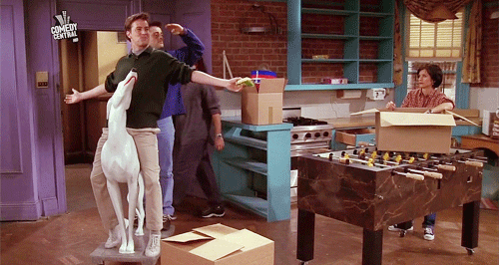
On average, 77.81% of the dialogues in the Friends scripts are positive.

Slide 3
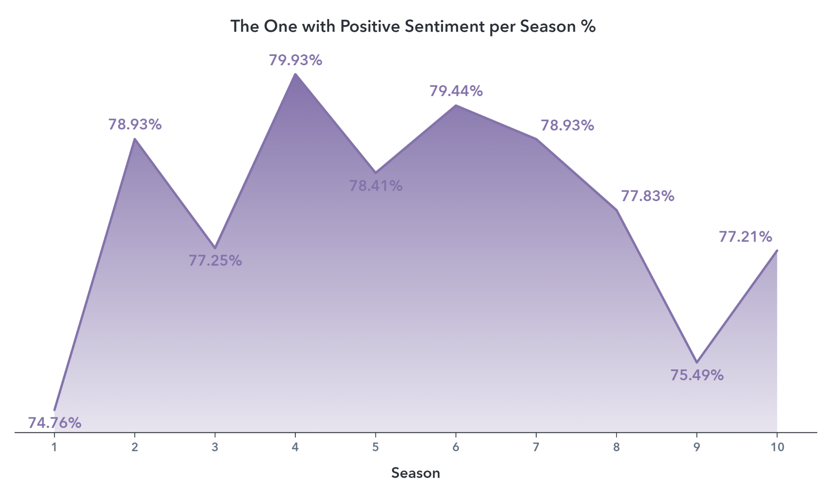
Average
Sentiment

Slide 4



TABLE OF CONTENTS
EDA
Initial Findings
Topic modeling
Character Affinity Analysis
Sentiment Analysis
Most positive and most negative character

Slide 5

Raw Data
228
50,509
6
episodes
dialogues
main characters

Slide 6
Data Preprocessing
Dialog Extraction
Scene Detail Removal
Sentence
Tokenization & Stop Word Removal
Porter Stemming

Slide 7
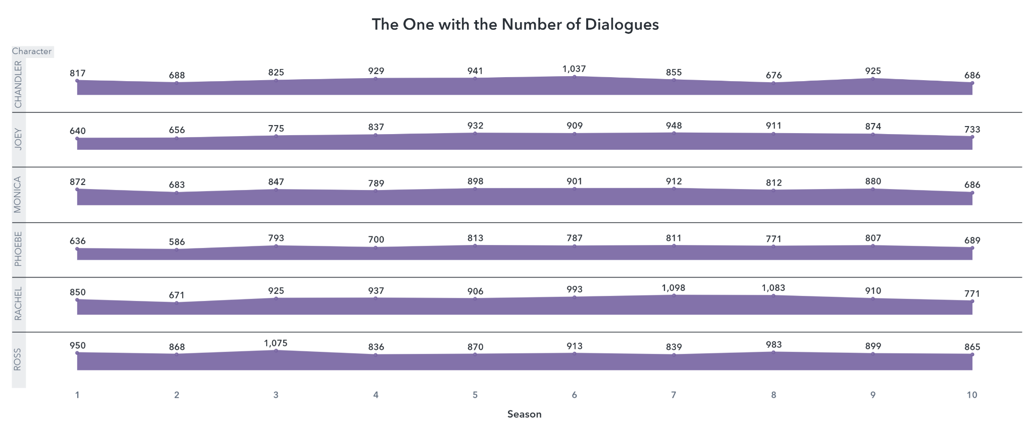

Slide 8
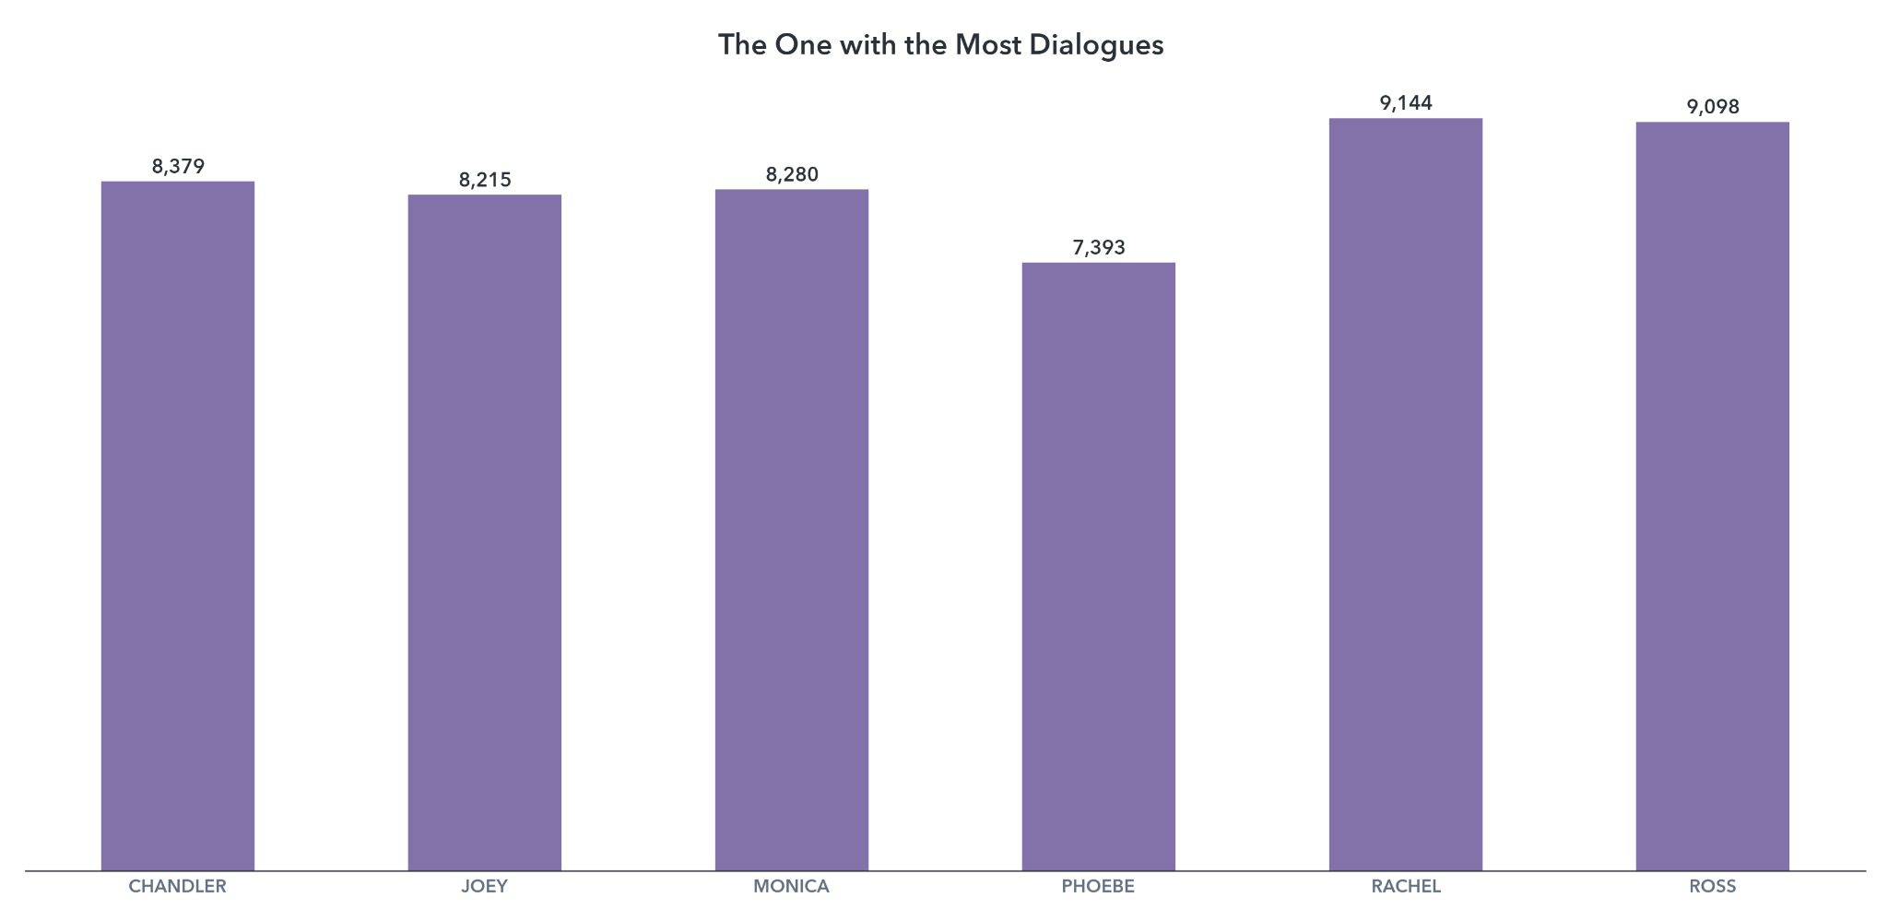

Slide 9

Topic MODELING

Slide 10




Topic Modeling
Topic modeling by season
Topic modeling by character
Character Affinity

Slide 11
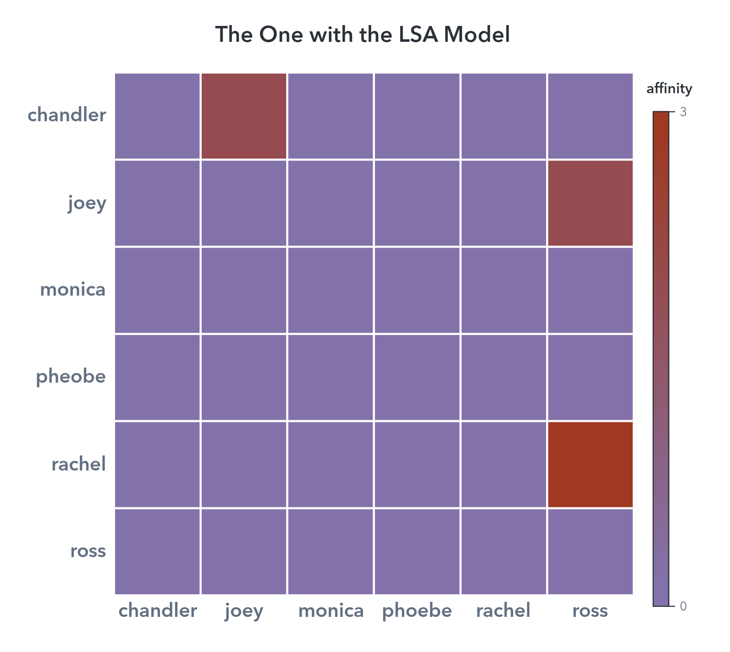
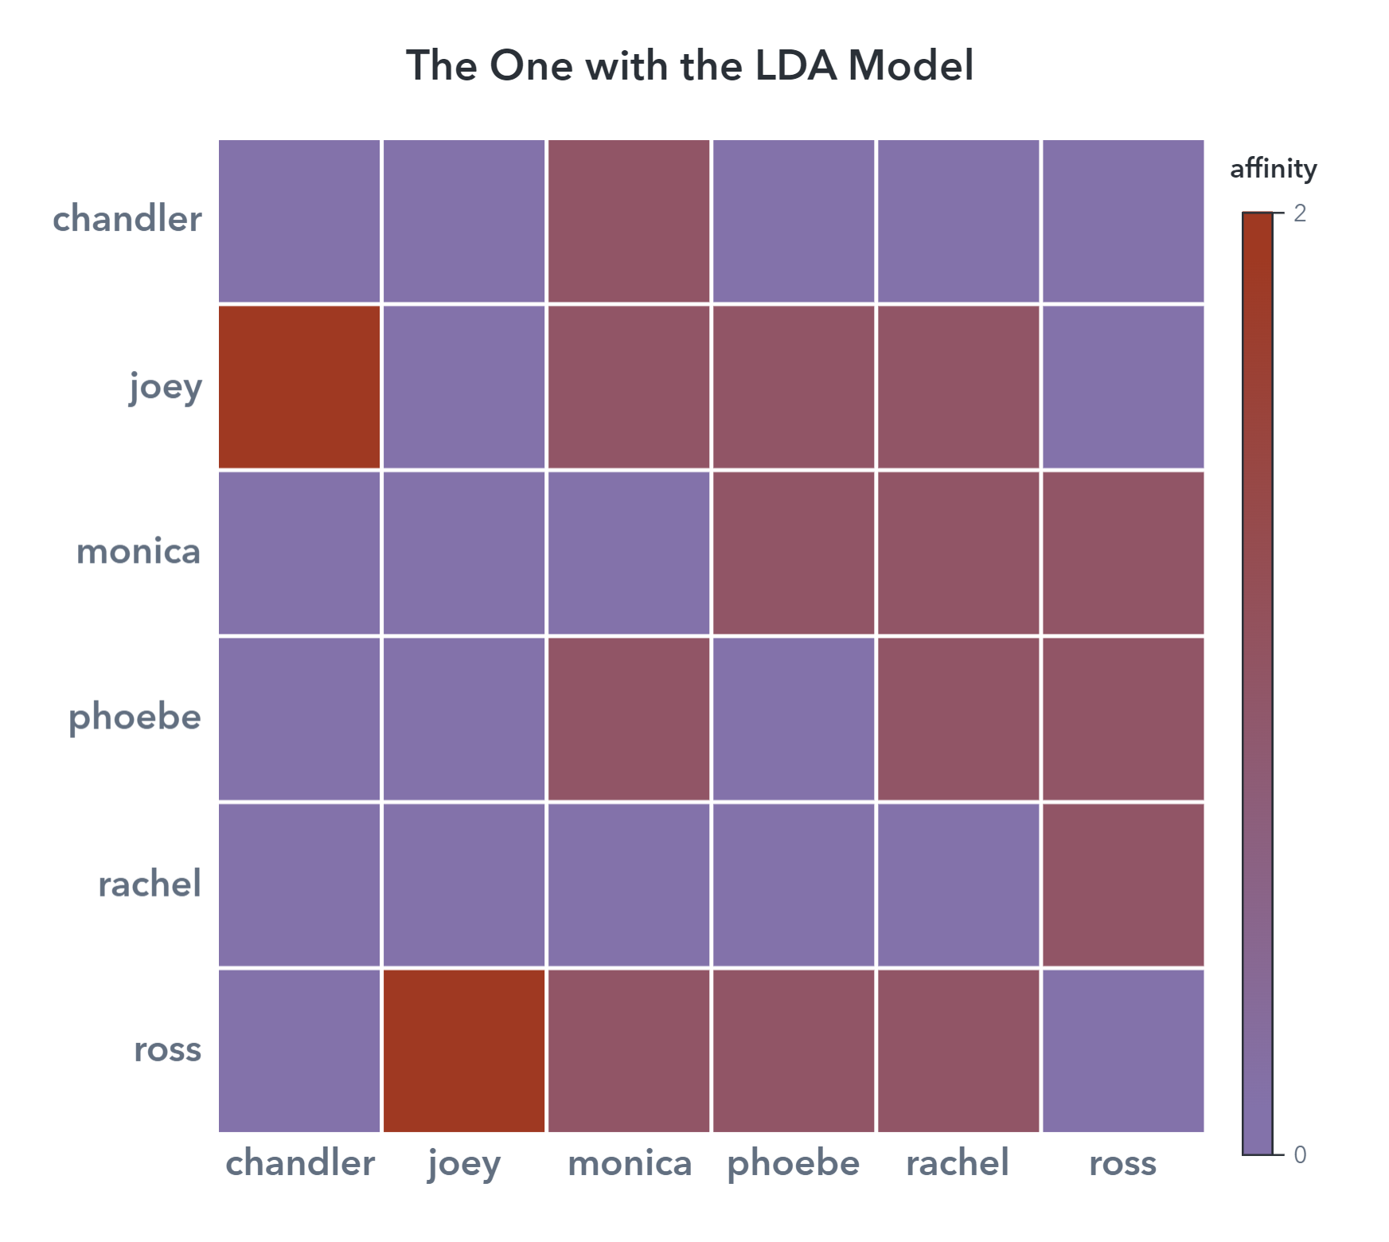

Slide 12

Sentiment Analysis

Slide 13
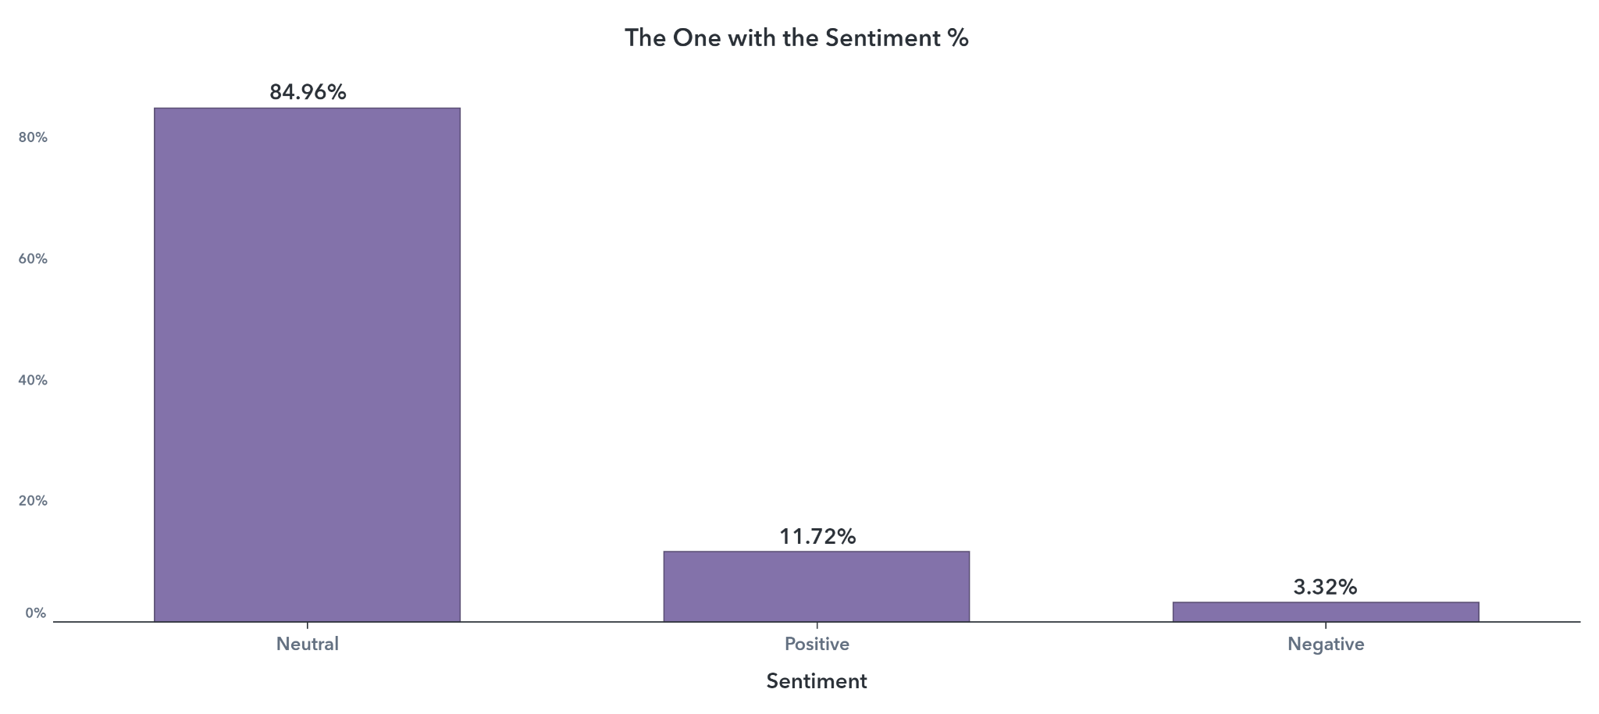

Slide 14
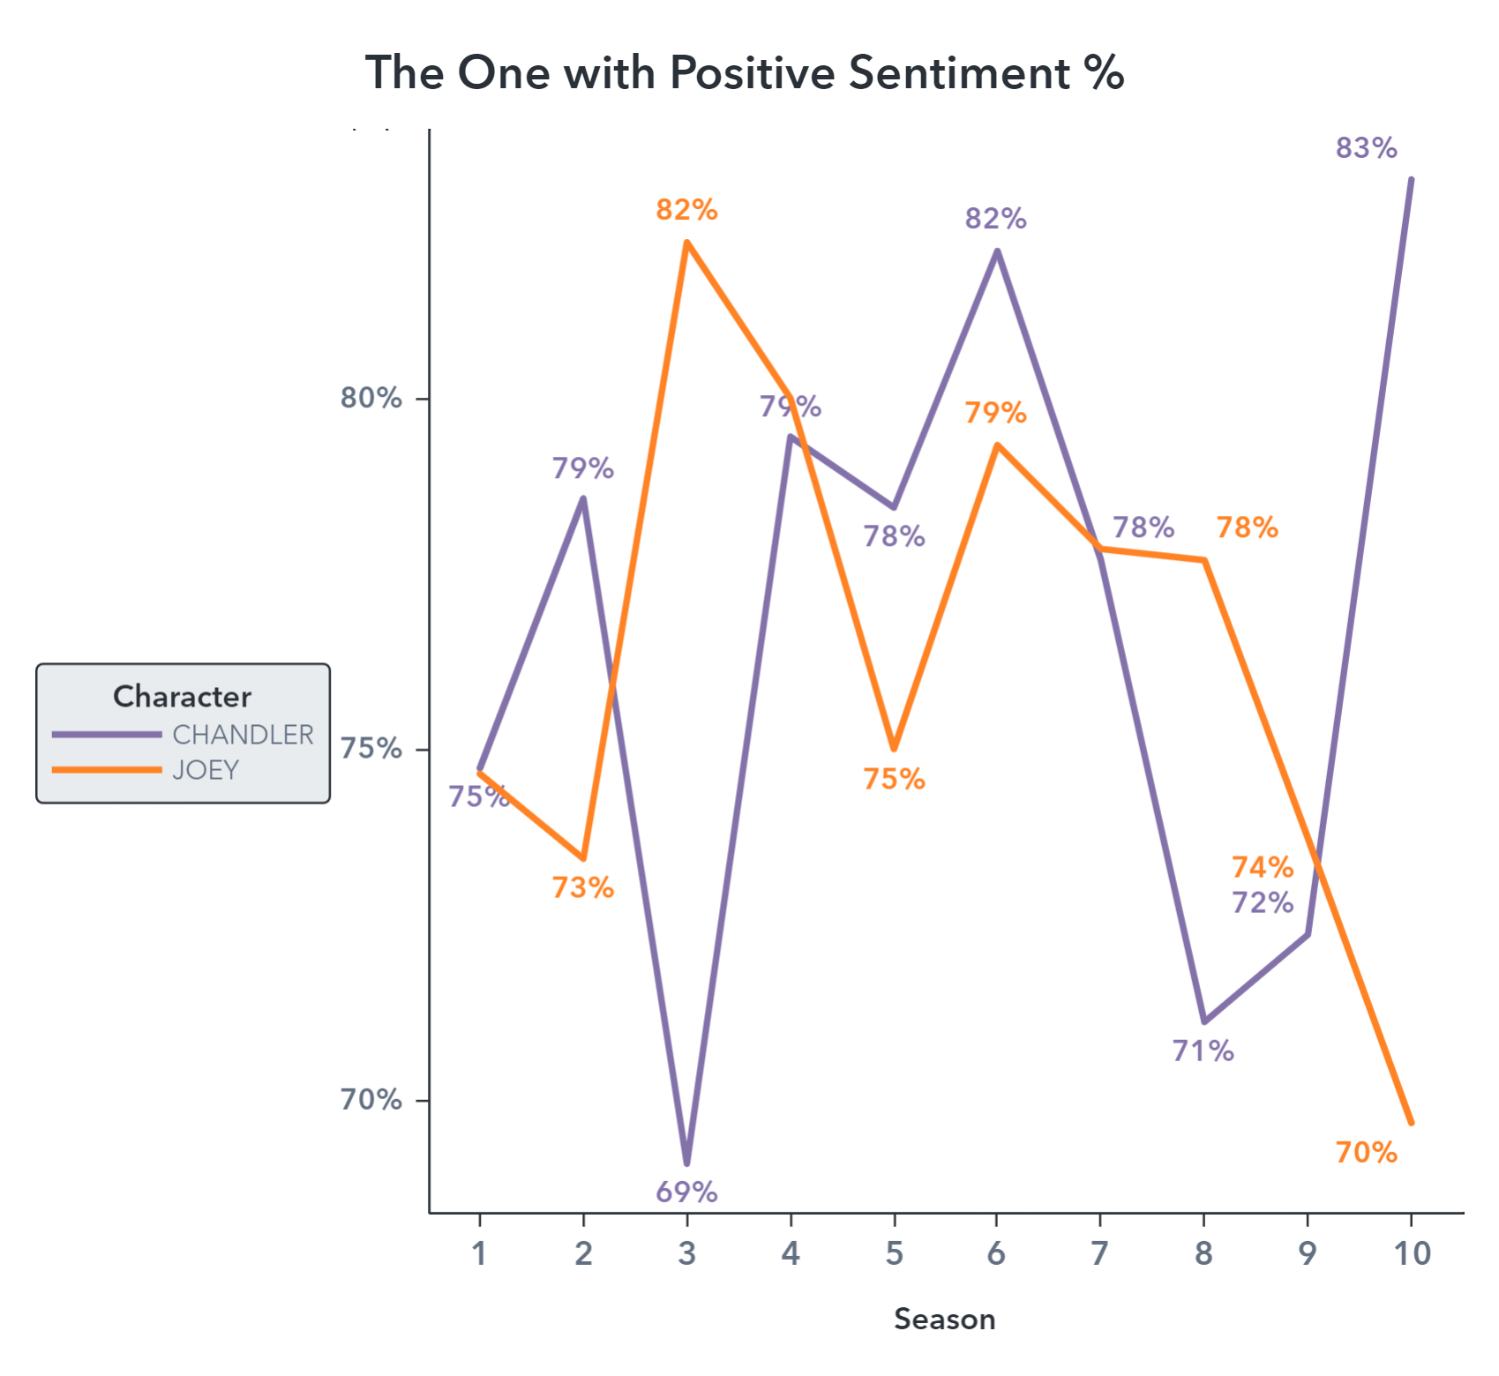

Slide 15
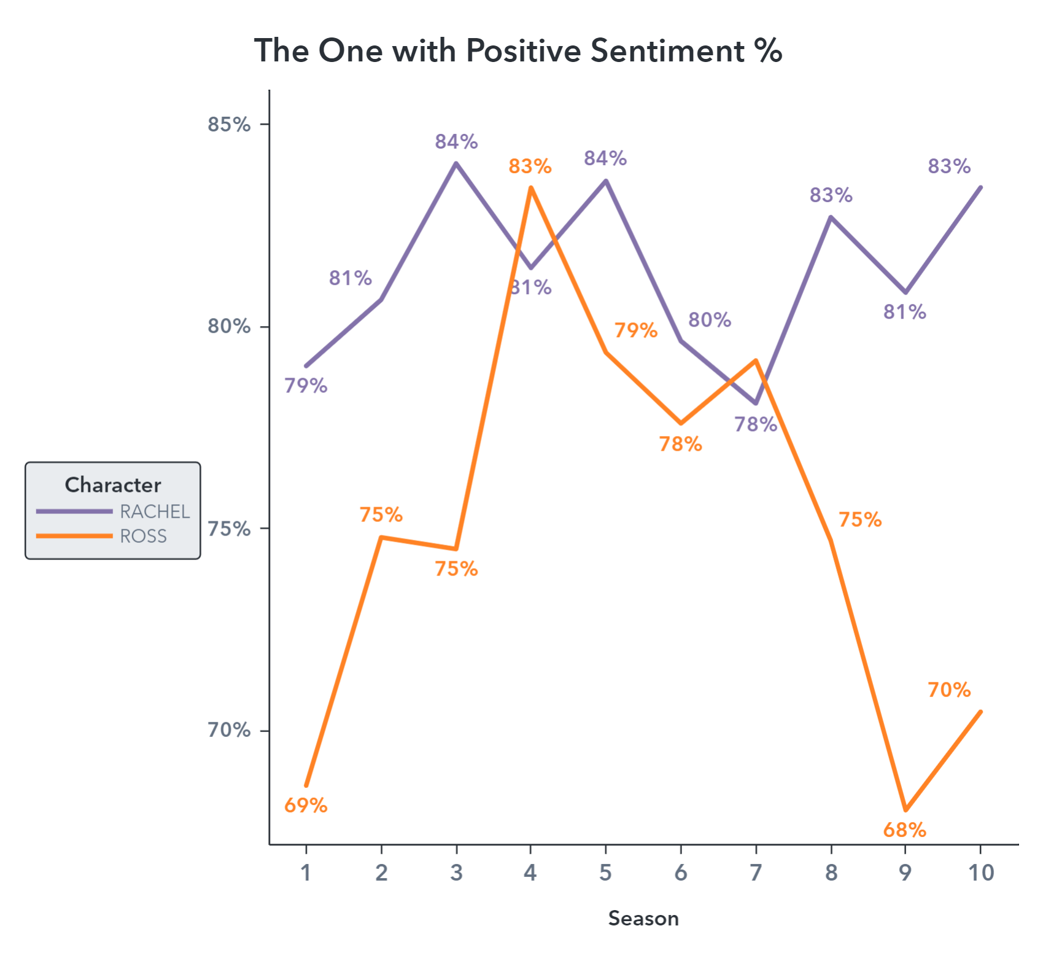

Slide 16
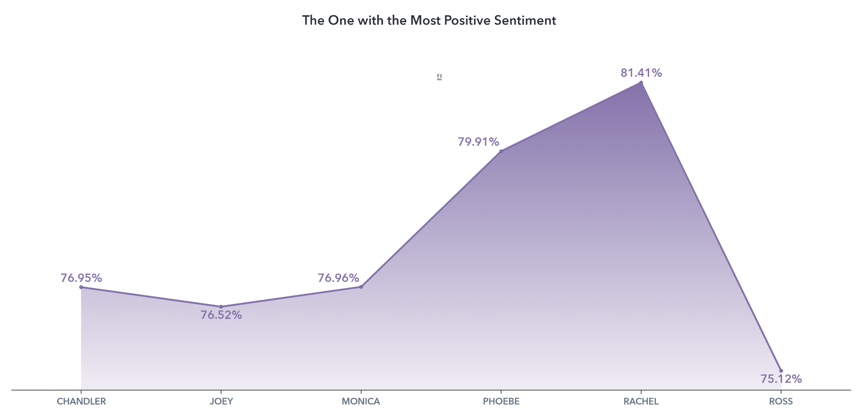

Slide 17
Q&A

Slide 18
THANKS!
Does anyone have any questions?
addyouremail@freepik.com
+91 620 421 838
yourcompany.com
Please keep this slide for attribution

Slide 19


